Slide 1
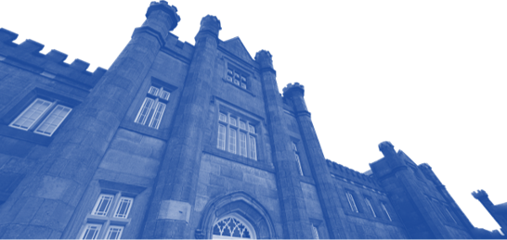
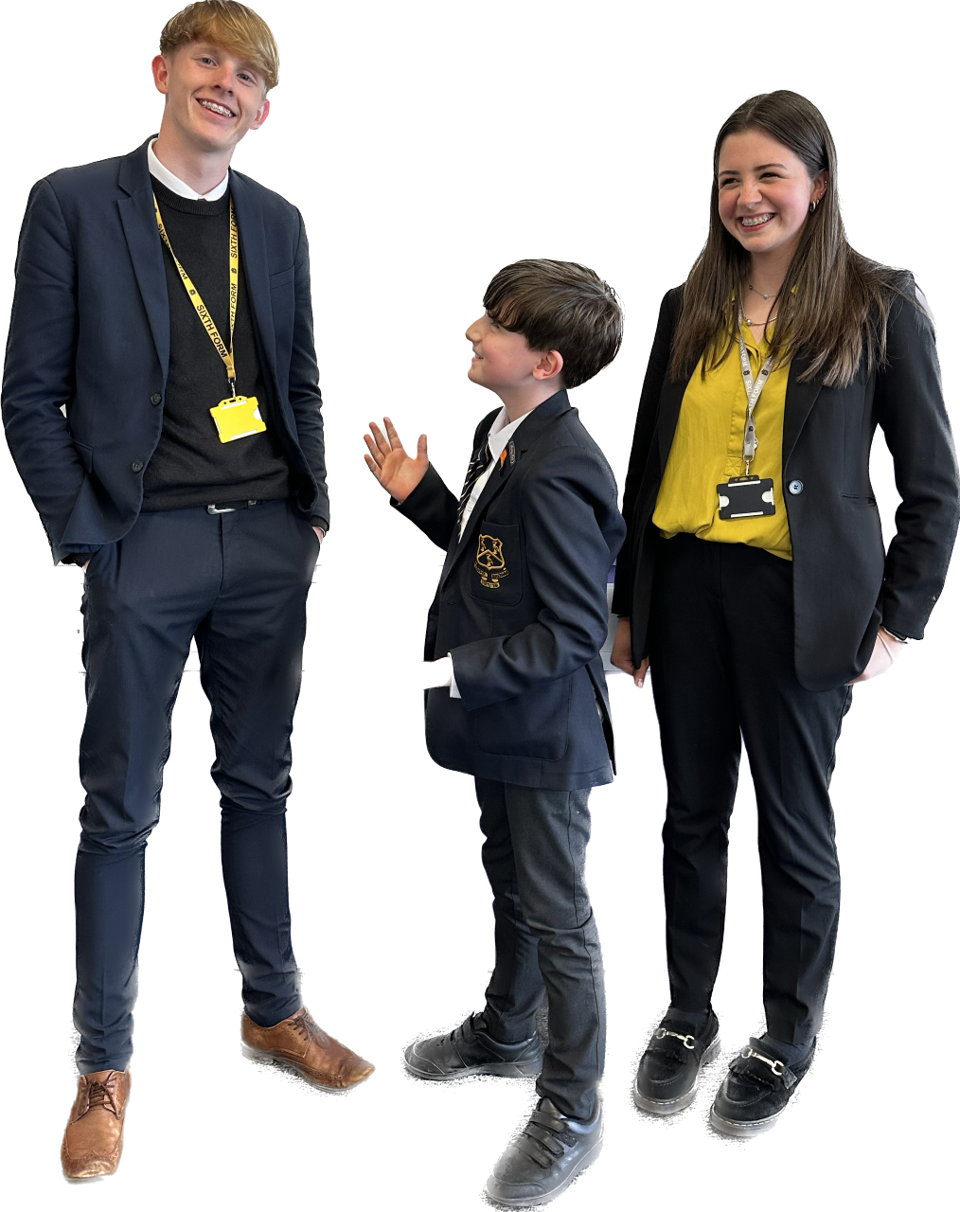
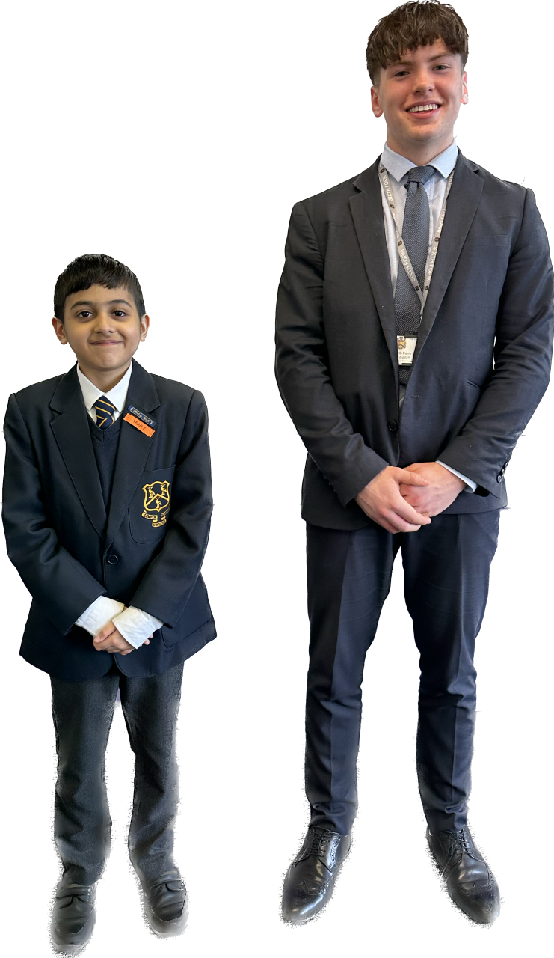
THE BLUE COAT
TRANSITION
#thejourney

Slide 2
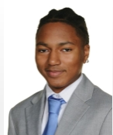
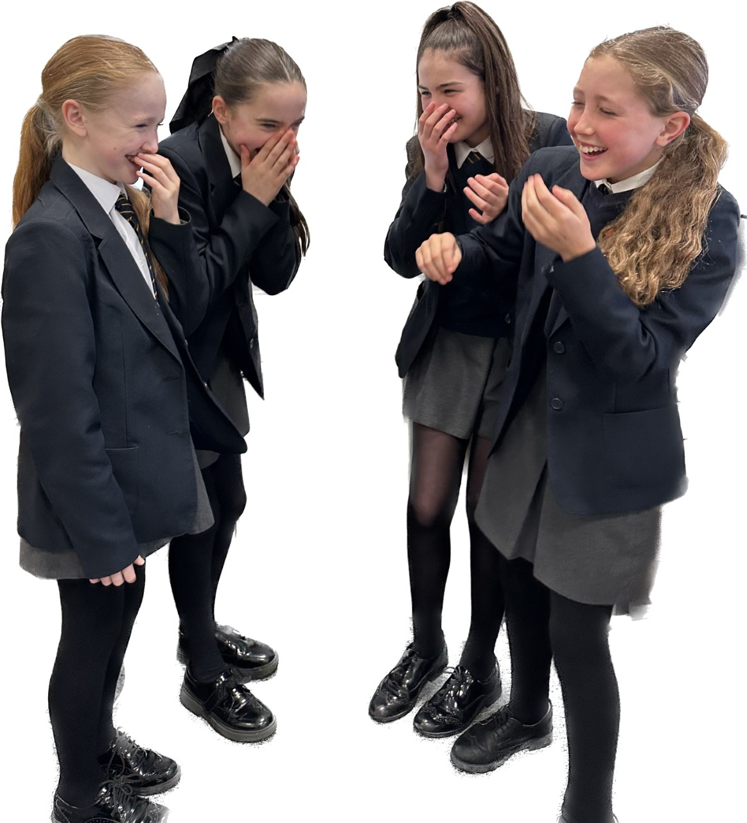
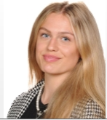
WHAT IS LIFE LIKE AT THE BLUE COAT?
Trust us
Blue Coat is a 5-7 year journey.
What might this journey look like?
Role Models
Notes:
DKE

Slide 3
WHAT MAKES US, US?

Slide 4
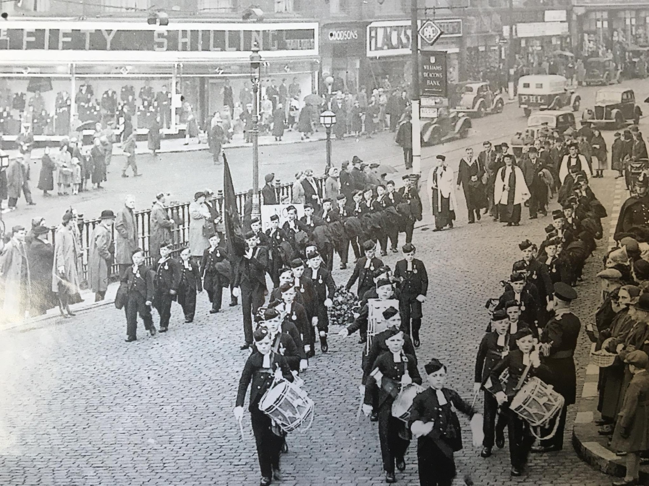
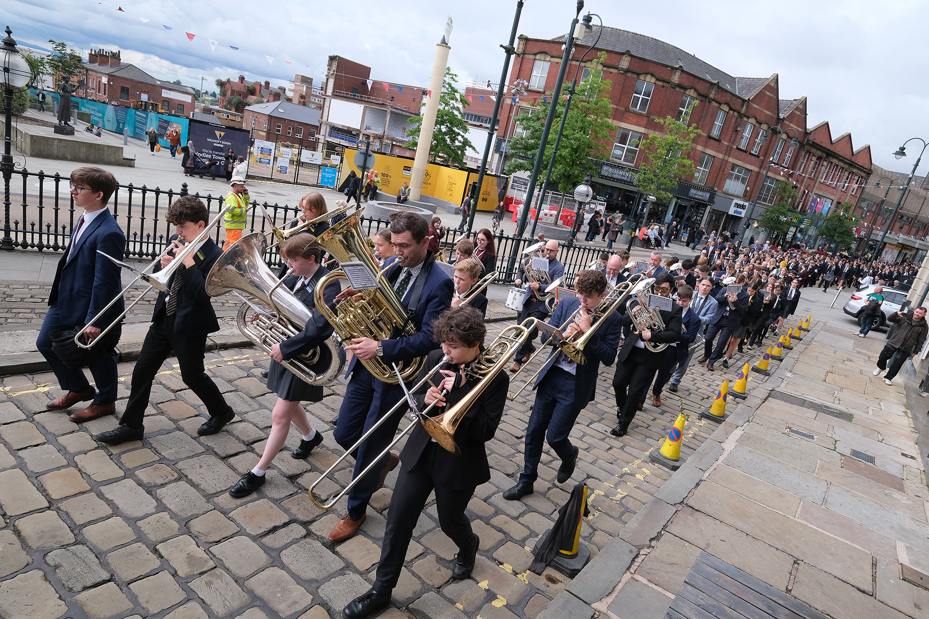
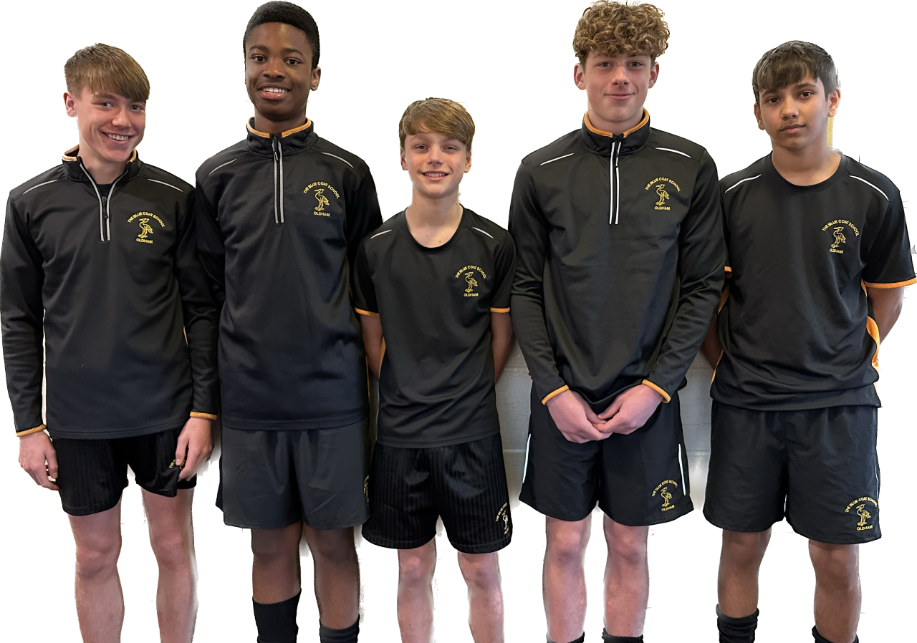
WHAT MAKES US, US?
Tradition, heritage and discipline

Slide 5
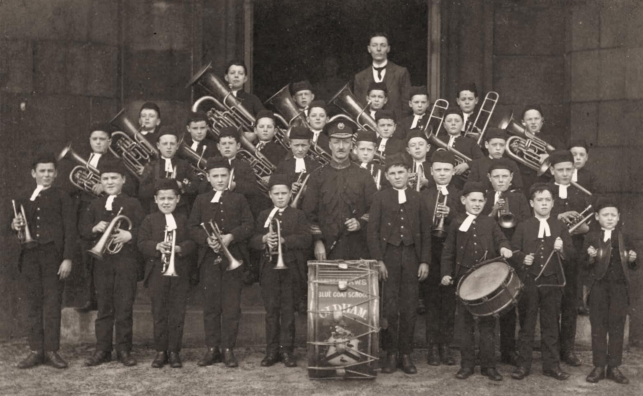
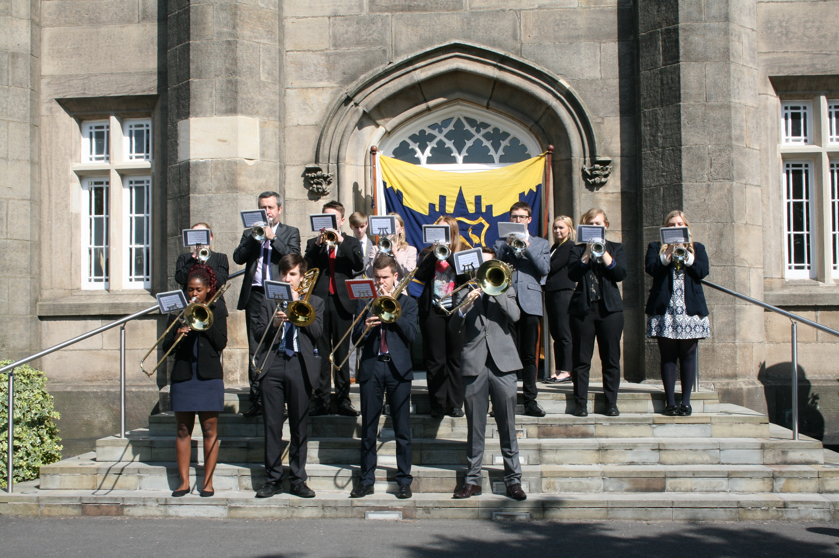
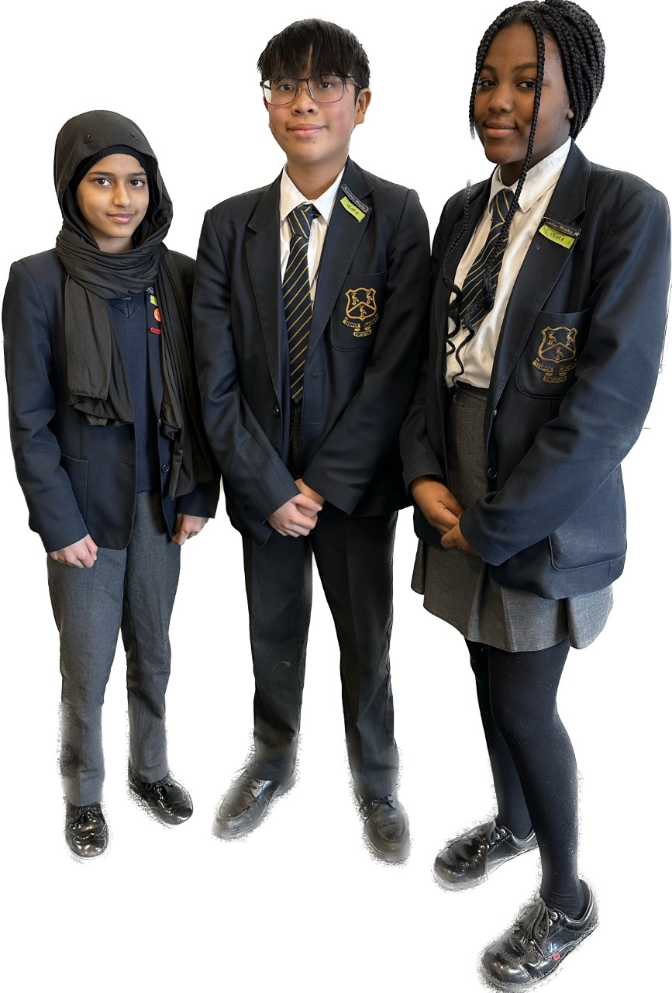
WHAT MAKES US, US?
We are part of something bigger than us.

Slide 6
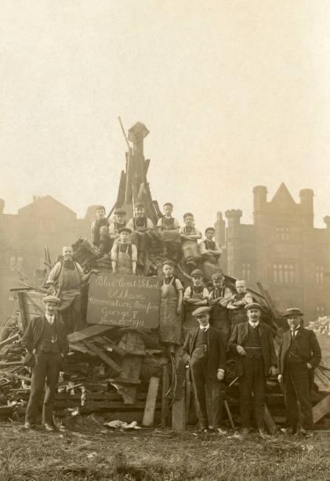
WHAT MAKES US, US?
...but we do evolve.

Slide 7
WHAT MAKES US, US?
Relationships.
Highest standards and expectations.
Sweat the small stuff…link to a bigger value.
Consistency is key.
Effective in our praise.
We explicitly narrate to pupils how far they have come.
Calm and supportive community.

Slide 8
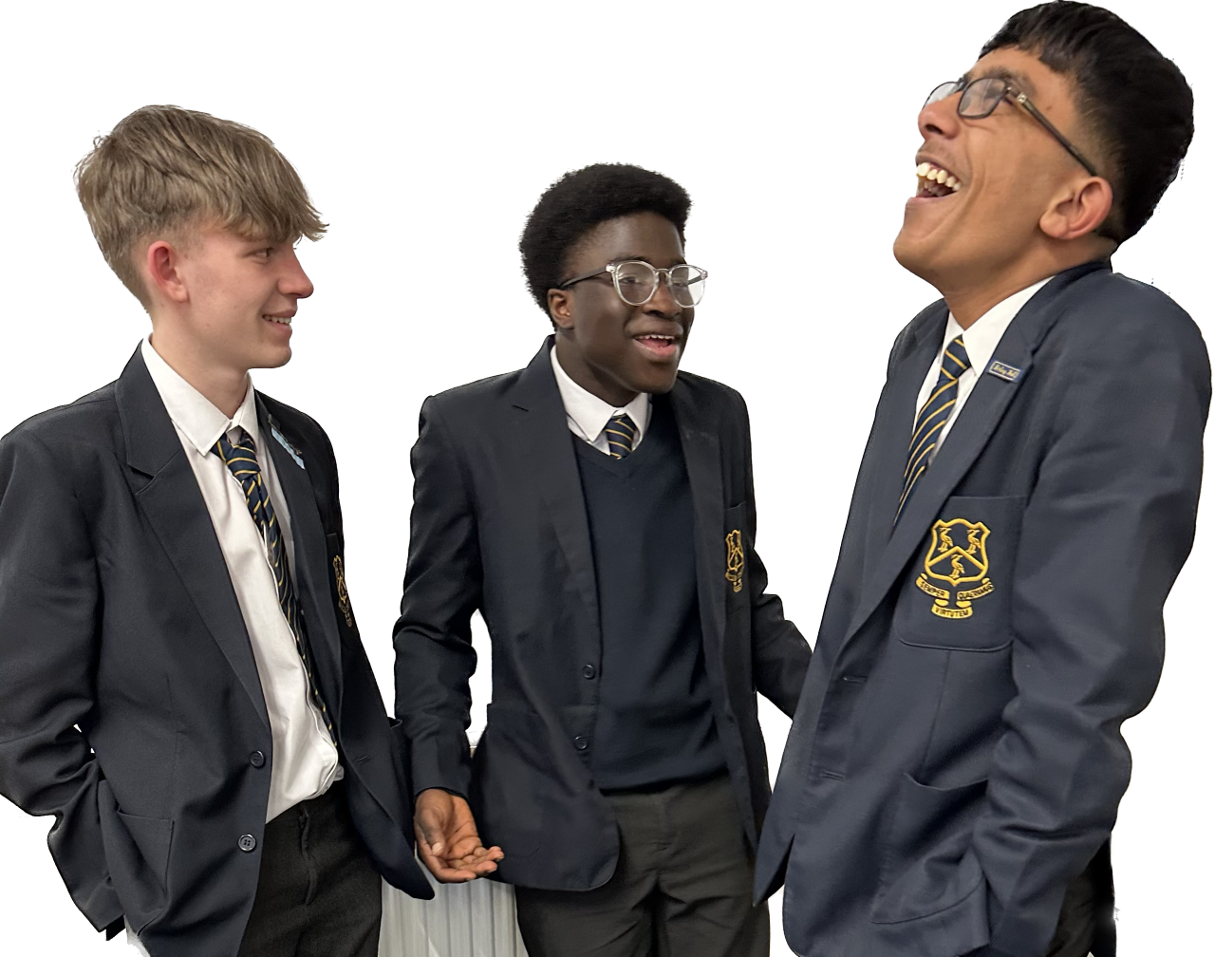
THE CHRISTIAN CHARACTER OF THE SCHOOL
“Living life to all its fulness” (John 10:10).
Developing talents in all areas of life: enabling discipline, confidence and delight in seeking wisdom and knowledge.
Education for hope and aspiration: enabling healing, repair and renewal, coping wisely when things go wrong as well as opening horizons.
Living well together. : a core focus on relationships, participation in communities and charity.
Basic principle of respect for the value and preciousness of each person.

Slide 9
CLIMBING MOUNTAINS
Peer influence
Friendships fallouts
Mobile phones and social media
Exposure and experimentation
Uniform
Town centre

Slide 10
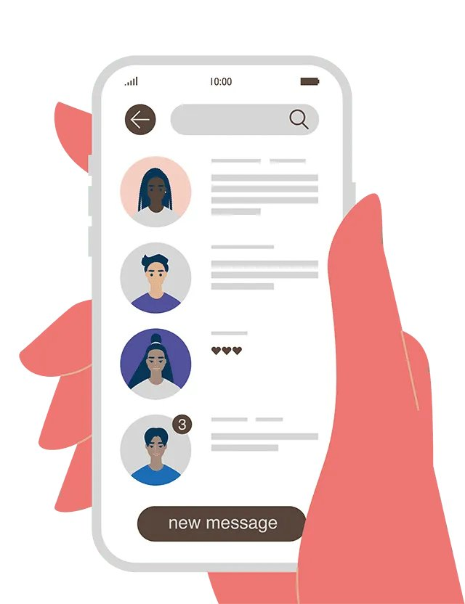
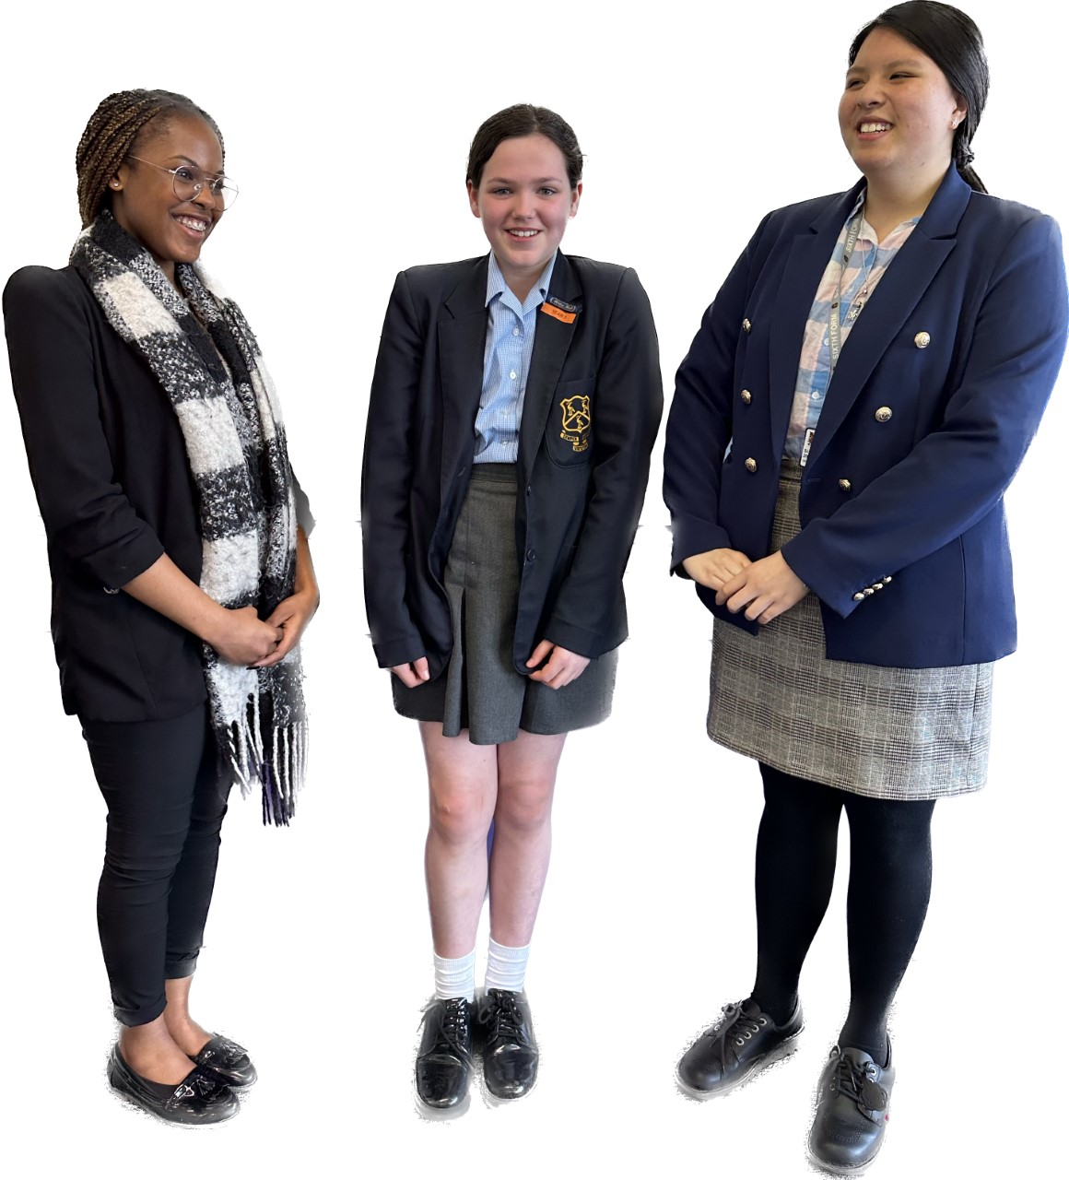
THE HOW…
'The more time teenagers spend looking at screens, the more likely they are to report symptoms of depression' (Twenge, 2017)
How have we created the community we have today?
A culture of shared values and expectations
Clear and practised routines
Research engaged policies
Consistently applied
Consistently supported
'Time on screens- even without social media- degrades attention and concentration' (Lemov, 2022)
'If kid's brains become accustomed to constant changes, the brain finds it difficult to adapt to a non-digital activity where things don't move as fast' (Manos, 2020)
'Schools that banned mobile phones got an increase in GCSE results' (Murphy, 2015)

Slide 11
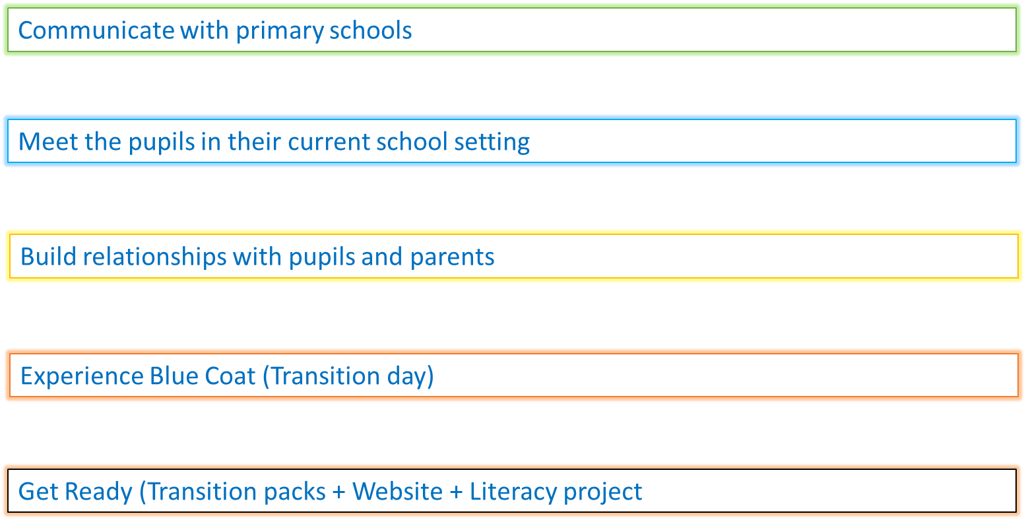
HOW DO WE PREPARE YOUNG PEOPLE?
It is a huge change for ALL young people

Slide 12
WHAT SHOULD WE EXPECT FROM TRANSITION DAY?
New Commute
Opportunity to make friends
Get used to new surroundings
Meet members of staff
Eat with us
Getting to know the children as learners
Lots of questions

Slide 13
WHAT SHOULD WE EXPECT FROM TRANSITION DAY?
Transition Day will take place on Thursday 4th July – A day in the life of a Blue Coat pupil.
8.30am- Arrival: Staff will be there to meet and greet but we ask that parents and carers drop off away from school site (unfortunately, you are not permitted to drive onto school site.) Don’t worry, we will look after them.
10.50am- Break time: Don’t forget to pack a snack and a drink. There are water fountains in the restaurant to refill water bottles.
12.50pm- Lunch time: A hot or cold lunch will provided for free but you will need to bring a drink. You may also wish to bring additional snacks and others may prefer a packed lunch.
3.15pm- Goodbyes (for now): Again, we ask parents and carers to arrange a collection point away from school. School buses will be available (please note some do not leave until 3.30pm). There will be staff on duty at the end of the day offering support to pupils.
Dress Code and Equipment - Students should come dressed in their full primary school uniform (not leavers hoodies). All students should bring a pen and pencil.
Parking – Be respectful to the local community.

Slide 14
IT TAKES A VILLAGE
Trust Communication

Slide 15
Blue Coat School PTA

Slide 16
Background
Previously there was no PTA within Blue Coat for many years, so we are a brand-new PTA recently formed.
The Blue Coat School PTA were officially created via the first AGM meeting during May 2024. Committee members are all parents of Blue Coat children.
The Group will meet on a regular basis with Mr Higgins, Blue Coat secretary and representatives from the teaching staff to discuss and plan events.
Our mission:
The PTA group are committed to facilitate a positive community between staff, pupils and parents/carers of the Blue Coat school and will help support a positive learning environment for all pupils.
Fundraising goals:
Long terms vision is to raise sufficient funds to donate to school to build an outdoor,
covered structured seating area for all pupils to access during their leisure time.
The structure will support children’s well-being by providing an alternative location to
enjoy their recreational time in the fresh air and it will be the first of its kind at Blue Coat.
In the short to medium term there are many other ways we want to work with you to
support school - PE kit sponsorship, buy a metre of carpet.

Slide 17
PTA asks of you:
We need you !
If you/your business are interested in helping the PTA , please get in touch – we would love to hear from you.
* Email address is BCS-PTA@outlook.com
Or contact school directly who will pass on your information
The aim of our group is to facilitate some fun, interesting events whilst raising money !
Please help support our fundraising journey by buying a raffle ticket to win some great prizes. All winners will be drawn by 18:30 this evening.
Thank you for your support.

Slide 18
PARENTS' INFORMATION EVENING
The first few weeks at The Blue Coat
School systems and structures
How to check homework
Battlefields
Social media workshop

